Slide 1
Can We Afford the Fundamentals of Care?
Jack Needleman, PhD FAAN
Professor and Chair, Department of Health Policy & Management
UCLA Fielding School of Public Health
Presented at
ILC Conference
University of Uppsala
June 12, 2017

Slide 2
Outline
Nursing matters – Nursing is a core service line of hospitals
So why does it need to make the case for staffing?
What do we mean by “can we afford?”
A reminder of the scope of nurses work
When nurses don’t have the time or training to do their work, patients and patient care suffer
Low hours and low skill mix
Is it causal?
Missed care
How much will staffing cost and what are the cost offsets?
Conclusion

Slide 3
Nursing matters – so why is there a need to make the case for nursing?
Searching for value
Cost control as ongoing concern in public health systems
Quality improvement & process/efficiency improvement linked
Agenda of bending the cost curve
Agenda of crossing the quality chasm
Nursing viewed as cost center, rather than service line
Labor largest element of hospital costs, nursing largest element of labor
Since late 1980s and 1990s, efforts to try to control costs by reducing nursing hours or substituting lower skilled staff for professional nurses
Implications
Need for nursing to establish
Service line
Contribution to value for organization (business case)
Need to change policy/payment to value what patients value
Nurses work needs to be redesigned to assure quality and efficiency
Work of nurses not understood by public, health care execs, other members of health care team
Encourages cost cutting, efforts to substitute lower skilled staff for RNs

Slide 4
What do we mean by “can we afford?”
Three different answers:
Getting more requires spending more
Contrast with case where can increase efficiency and get more for same or same for less
Not worth the additional cost
Would break the budget
Even if value, higher value elsewhere that need to preserve
Can’t shift spending to this area
Conflicting interests, so who decides
Business case: there’s value here but it costs us more than we recover
Deciding whether we can afford requires accounting for not only direct costs, but cost offsets (savings from the additional spending)
Payment system influences whether hospital or health system retain savings

Slide 5
Outline
Nursing matters – Nursing is a core service line of hospitals
So why does it need to make the case for staffing?
What do we mean by “can we afford?
A reminder of the scope of nurses work
When nurses don’t have the time or training to do their work, patients and patient care suffer
Low hours and low skill mix
Is it causal?
Missed care
How much will staffing cost and what are the cost offsets?
Conclusion

Slide 6
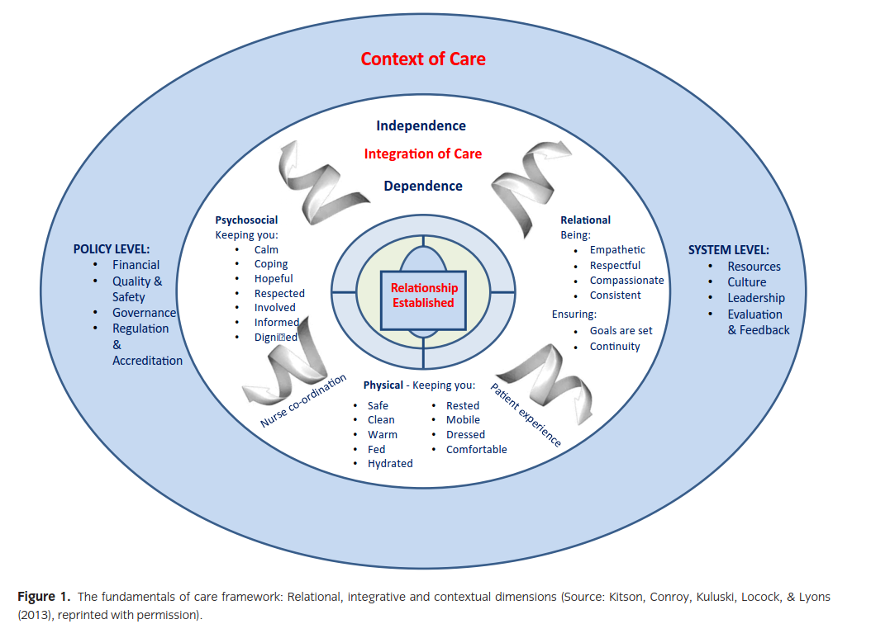
Fundamentals of Care A positive statement of what well-delivered care looks like
Source: Kitson, A. L., A. Muntlin Athlin, and T. Conroy. "Anything but Basic: Nursing's Challenge
in Meeting Patients' Fundamental Care Needs." J Nurs Scholarsh 46.5 (2014): 331-9.

Slide 7
Nurses’ work is cognitively, intellectually and managerially challenging work
Public and too many health care executives understand nursing is physically and emotionally demanding, but too little appreciation that work of front line nurses is cognitively, intellectually and managerially complex
My interview with the New York Times
Stereotype of nurses: deliver ordered care, administer drugs, take vital signs, help patients eat, go to the bathroom, bath
They do and this is part of fundamentals of nursing care, but…

Slide 8
The cognitive work of nurses
Cognitive and intellectual demands of work:
Backstop rest of care system:
Check for errors in orders, especially drugs
If something ordered, not delivered, follow up
Responsible for preventing errors of commission and omission
Monitor and assess patients
For risks of falls, pressure ulcers, delirium and disorientation
Progress as expected or problems or developing complications
Pain
Mental status, especially depression and agitation
Initiate appropriate interventions for prevention or treatment to keep patient, staff and others safe
Often principal coordinators of interprofessional teams that include physicians, pharmacists, social workers and other providers
Targeted education for patients and families to prepare for safe discharge and reduce the risk of readmission
Emotional, psychological and existential support for patients and families

Slide 9
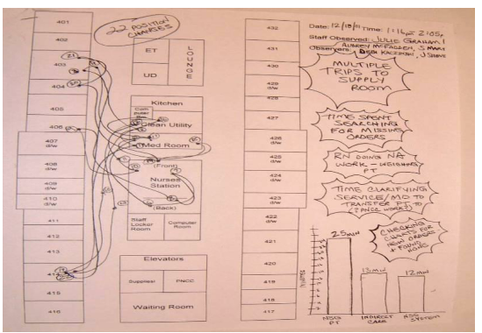
Nurses work is managerial demanding Providing care for 4-8 patients requires extraordinary ability to “manage the stack” of constantly changing tasks to meet each patient’s needs
One nurse, 50 minutes of one shift, 22 position changes
Source, Institute for Healthcare Improvement, TCAB How-to Manual on Nurse Time in Direct Patient Care, 2008

Slide 10
Economics of nursing: Social vs Business Case
Research shows having adequate nurse staffing can reduce lengths of stay, complications and mortality
Social value of reduced deaths, adverse events, shorter stays exceed costs of higher nursing hours and skill mix – social case is clear
But value to hospital depends on whether savings accruing to it exceed its costs
Going to focus on business case issues in presentation

Slide 11
Review of research on staffing and quality
1996 IOM report
“Serious paucity of recent research” on nurse staffing and quality
Call for rigorous research
In decade following, substantial research
US: Needleman, Buerhaus; Aiken et al.; Mark et al; Kovner; Blegen and others
Most research based on comparing high staffed to low staffed hospitals
Variety of data sources for staffing
Typically, single estimate for year or from single survey
Variety of outcomes, with mortality and failure to rescue particularly compelling
Research extended to Canada, Europe (RN4Cast), Australia, Asia with similar results

Slide 12
Meta-analysis of multiple studies Pooled Odds Ratios of Patient Outcomes Corresponding to an Increase of 1 Registered Nurse Full Time Equivalent per Patient Day
Outcome | Studies | Odds Ratio
Mortality, hospital, all patients | 5 | 0.96
Mortality, intensive care units | 5 | 0.91
Mortality, surgical patients | 8 | 0.84
Mortality, medical patients | 6 | 0.94
Hospital-acquired pneumonia | 4 | 0.81
Cardiopulmonary resuscitation | 5 | 0.72
Surgical patients failure to rescue | 5 | 0.84
Surgical wound infection | 1 | 0.15
Nosocomial bloodstream infection (Surgical) | 5 | 0.64
Relative change in length of stay (Surgical) | 3 | 0.69
All ORs significant at 0.05 level OR below 1.0 positive effect of nursing on outcome OR of 0.9 implies a reduction of risk of approximately 10%
Source: Kane, 2007

Slide 13
Avoided Days and Adverse Outcomes Associated with Raising Nurse Staffing Levels and Mix to 75th Percentile Estimates from Needleman/Buerhaus, Health Affairs, 2006
 | Raise RN Proportion | Raise Licensed Hours | Do Both
Avoided Days | 1,507,493 | 2,598,339 | 4,106,315
Avoided Adverse Outcomes Cardiac arrest and shock, pneumonia, upper gastrointestinal bleeding, deep vein thrombosis, urinary tract infection | 59,938 | 10,813 | 70,416
Avoided Deaths | 4,997 | 1,801 | 6,754

Slide 14
Since Kane, 2007
Replication of results for outcomes observed
Addition of other outcomes, notably readmissions
Additional international work finding association
Aiken, L. H., et al. "Nurse Staffing and Education and Hospital Mortality in Nine European Countries: A Retrospective Observational Study." Lancet 383.9931 (2014): 1824-30. Print.
Griffiths, P. "Staffing Levels and Patient Outcomes." Nurs Manag (Harrow) 16.6 (2009): 22-3. Print.
Twigg, D. E., et al. "Is There an Economic Case for Investing in Nursing Care--What Does the Literature Tell Us?" J Adv Nurs 71.5 (2015): 975-90. Print.
Many Canadian studies
Continued work demonstrating importance of skill mix as well as hours
Needleman, et al., NEJM 2002
Aiken, “Nursing skill mix in European hospitals: cross-sectional study of the association with mortality, patient ratings, and quality of care,” BMJQS, 2017

Slide 15
The association of staffing and outcomes: Is it causal?
Because much research finding association of staffing and outcomes compares high staffed to low staffed hospitals, some skeptics raise question of whether it is staffing or something else about high staffed hospitals that causes these correlations
However, three strands of evidence help demonstrate these associations are causal
Extensive controls for technology, teaching, location, accreditation, ownership and patient status in the multiple studies of stafifng and outcomes
The “something else’s” are controlled for
Needleman 2006 NEJM study of shift-to-shift variations in staffing within a single high quality institution controls for other variables except nurse staffing
Lower than target staffing associated with higher mortality
Increased modeling of pathways by which staffing levels can influence adverse events
Especially missed care

Slide 16
Modeling pathways of causality: How missed care “explains” the impact of staffing on outcomes
Of the proportion of falls explained by staffing hours per patient day, approximately
one-third is associated with missed care

Slide 17
Selected studies showing relationship between staffing, missed care and outcomes include:
Studies showing relationship between staffing and care
Dabney, B. W. and B. J. Kalisch. 2015. “Nurse Staffing Levels and Patient-Reported Missed Nursing Care.” J Nurs Care Qual.
Jha, A. K., E. J. Orav, J. Zheng, and A. M. Epstein. 2008. “Patients’ Perception of Hospital Care in the United States.” New England Journal of Medicine 359: 1921-31.
Studies showing relationship between care and outcomes
Schubert, M., S. P. Clarke, L. H. Aiken, and S. De Geest. 2012. “Associations between rationing of nursing care and inpatient mortality in Swiss hospitals.” International Journal for Quality in Health Care 24(3): 220-38.
Studies showing care and missed care mediates relationship between staffing and outcomes
Ball, J. E., T. Murrells, A. M. Rafferty, E. Morrow, and P. Griffiths. 2014. “'Care left undone' during nursing shifts: associations with workload and perceived quality of care.” BMJ Qual Saf 23(2): 116-25.
Bruyneel, L., B. Li, D. Ausserhofer, E. Lesaffre, I. Dumitrescu, H. L. Smith, D. M. Sloane, L. H. Aiken, and W. Sermeus. 2015. “Organization of Hospital Nursing, Provision of Nursing Care, and Patient Experiences With Care in Europe.” Med Care Res Rev.
Kalisch, B. J., B. Xie, and B. W. Dabney. 2014. “Patient-Reported Missed Nursing Care Correlated With Adverse Events.” American Journal of Medical Quality 29(5): 415-22.
Kalisch, B. J., D. Tschannen, and K. H. Lee. 2012. “Missed Nursing Care, Stafﬁng, and Patient Falls.” Journal of Nursing Care Quality 27(1): 6-12.

Slide 18
What we measure is often the failure to deliver the fundamentals of care
4 instruments of note:
US Hospital Consumer Assessment of Healthcare Providers and Surveys
Post-hospitalization patient survey of experience of care
Kalisch MISSCARE
Nurse report of how often elements of care missed on unit
Basel Extent of Rationing of Nursing Care (BERNCA) survey
Identification of care missed by surveyed nurse
Modified version used in RN4CAST European multicountry assessment of nursing care
Kalisch MISSCARE – Patient Survey
Elements of care patients able to report on
Patients do notice!!

Slide 19
Nurses reporting “care left undone,” RN4Cast, Sweden
 | RN4Cast % | Sweden %
Any care missed | 87 | 75
Comfort/talk with patients | 66 | 46
Educating patients and family | 52 | 26
Develop/update nursing care plans/care pathways | 47 | 34
Adequate patient surveillance | 35 | 20
Adequately document nursing care | 33 | 25
Oral hygiene | 29 | 31
Frequent changing of patient position | 28 | 20
Planning care | 28 | 11
Administer medications on time | 23 | 25
Skin care | 21 | 25
Prepare patient and families for discharge | 20 | 16
Treatments and procedures | 11 | 6
Pain management | 7 | 6
Sources:
Ball, J. E., T. Murrells, A. M. Rafferty, E. Morrow, and P. Griffiths. 2014. “'Care left undone' during nursing shifts: associations with workload and perceived quality of care.” BMJ Qual Saf 23(2): 116-25.
Ball, J. E., P. Griffiths, A.M. Rafferty, R. Lindqvist, T. Murrels, C. Tishelman. 2016. "A cross-sectional study of ‘care left undone’ on nursing shifts in hospitals." Journal of Advanced Nursing 72(9): 2086–2097

Slide 20
And in Sweden, as elsewhere, missed care is associated with more patients/nurse

Slide 21
Patients are entitled to nurse staffing that assures safe and reliable care
To sum up to this point
Nurses work is complex, cognitively and managerially demanding
The evidence is substantial that when RN staffing levels or skill mix is low, length of stay and adverse events are higher than they need to be
Longer lengths of stay are measures of both quality and efficiency, the ability of nurses to get their care done.
This relationship is causal
Policy and management should reflect this
Patients are entitled to staffing that assures safe and reliable care
Competition and public reporting (Consumer Reports model) not sufficient
Patients don’t always have choice of hospital
Nursing is core service of hospital
Patients should be able to expect the hospital can deliver care safely and reliably (Underwriters Laboratory model)

Slide 22
But is fundamental nursing care affordable? Does it save more than it costs? If not, how much more?
When assessing costs of improved nurse staffing, need to consider not only the cost of higher staffing but cost offsets:
Shorter stays, reduced adverse events, reduced readmissions and better work environment that reduces turnover
Four studies that address these questions find:
Higher RN mix of RN and LPNs cost saving
Higher nursing hours add less than 1.5% to hospital costs and may add no costs:
Microsimulation studies show small net cost
Needleman 2006, Dall 2009, Shamliyan Kane 2009
Direct regression of per admission cost on staffing levels finds no statistically significant increase in cost/admission in hospitals with higher staffing per patient
Rand study (Martsolf 2014 Medical Care)
Looking only at the increased cost of nursing, ignoring the offsetting cost savings provides a misleading picture of the net cost of safe staffing levels
Given the offsetting cost savings, safe staffing levels can be achieved with little or no net cost to the hospital

Slide 23
Needleman, Buerhaus, Business Case for Nursing
Needleman, Buerhaus, NEJM, 2002 examined two dimensions of staffing
Hours/patient day
RN/LPN mix
Wide variation across hospitals
Robust association of staffing variables and outcomes for:
Medical patients: length of stay, urinary tract infection, pneumonia, upper GI bleeding
Surgical patients: failure to rescue
Incorporated results into business case analysis in Health Affairs, 2006 by estimating impact of moving lower staffed hospitals up
Updated in Needleman, PPNP, 2008, “Is What's Good For The Patient Good For The Hospital? Aligning Incentives And The Business Case For Nursing”

Slide 24
Avoided Days and Adverse Outcomes Associated with Raising Nurse Staffing Levels and Mix to 75th Percentile Estimates from Needleman/Buerhaus, Health Affairs, 2006
 | Raise RN Proportion | Raise Licensed Hours | Do Both
Avoided Days | 1,507,493 | 2,598,339 | 4,106,315
Avoided Adverse Outcomes Cardiac arrest and shock, pneumonia, upper gastrointestinal bleeding, deep vein thrombosis, urinary tract infection | 59,938 | 10,813 | 70,416
Avoided Deaths | 4,997 | 1,801 | 6,754

Slide 25
What are the costs and cost offsets of increased nurse staffing Estimates from Needleman/Buerhaus, Health Affairs, 2006
 | Raise RN Proportion | Raise Licensed Hours | Both
Cost of higher nursing | $ 811 Million | $ 7.5 Billion | $ 8.5 Billion
Avoided costs (full cost) | $ 2.6 Billion | $ 4.3 Billion | $ 6.9 Billion
Long term cost increase | ($ 1.8 Billion) | $ 3.2 Billion | $ 1.6 Billion
As % of hospital costs | -0.5% | 0.8% | 0.4%
Short term cost increase (save 40% of average) | ($ 2.4 Billion) | $ 5.8 Billion | $ 5.7 Billion
As % of hospital costs | -0.1% | 1.5% | 1.4%

Slide 26
Conclusions
Principal source of avoided costs is avoided days
LOS reduction across all patients, but complications rare
LOS change approximately ¼ day of a 5 day admission
Some due to reduced complications, both measured and unmeasured
Also likely associated with improved ability of nurses to deliver care efficiently
Complete admission/discharge process & reduce delays
Given relative magnitude of savings, it is unlikely that increasing complications included in analysis would substantially add to cost savings
Dall, et al., Medical Care adds more adverse events, alternative modeling, similar conclusion
Given current nursing models:
Increasing RN share of licensed pays for itself
Increasing hours do not appear to pay for themselves
However…

Slide 27
Recent study found increased staffing did pay for itself
Martsolf et al., “Examining the value of inpatient nurse staffing: an assessment of quality and patient care costs,” Medical Care, 2014
“Increases in nurse staffing levels were associated with…
“reductions in nursing-sensitive adverse events and length of stay
“but did not lead to increases in patient care costs.
“Changing skill mix by increasing the number of registered nurses, as a proportion of licensed nursing staff, led to reductions in costs.
What’s different in this study from prior business case:
Different methods
Analyzes costs in same data base as adverse events and LOS
Does not try to isolate the associated costs of higher nursing levels
If confirmed in additional research, important support to argument that higher staffing that increases safe and reliable care is affordable.

Slide 28
Regression-based estimates of changes in cost/admission of higher staffing
Change in cost/admission
 |  | 95% Confidence interval
Staffing Measure | Estimate | Low | High
% Licensed that are RN | $ (87) | $ (154) | $ (20)
RN+LPN hours per 1000 inpatient days | $ 167 | $ (35) | $ 368
Source: Martsolf, 2014

Slide 29
Table from Martsolf 2014 showing regression estimates of changes in cost/admission of higher staffing

Slide 30
A business case consideration: Who retains the gains from better nursing care
Under per admission payment, like DRGs, or overall budget
The hospital
Under charge based, fee-for-service or per diem payment
The payer (passed on to the patient in lower premiums?)
Should payer compensate hospital for better outcomes and savings?
Under value based payment incentives
ACOs, etc.
Shared savings

Slide 31
Conclusions
Strong case for nursing as core service line of hospitals, with adequate levels and skill mix of nursing associated with shorter lengths of stay, fewer hospital-acquired complications, and fewer readmissions
Not appreciated because full scope of nurses work not understood
Including by nurses and nursing students
Nurses need to tell their story better
Economic costs of adequate staffing modest to zero when cost offsets taken into account
Deskilling is a bad idea, likely to increase costs
Improving hours improves outcomes at modest cost
More for more
Key gain is shorter length of stay, improved throughput
Nurses need to embrace role of improving quality, patient experience and efficiency of care in hospitals and other settings – This is part of FoC
Nurses should be advocates for more bundled care so hospitals retain gains from reduced length of stay and hospital-acquired complications
Education needs to prepare nurses to play this role

