Slide 1
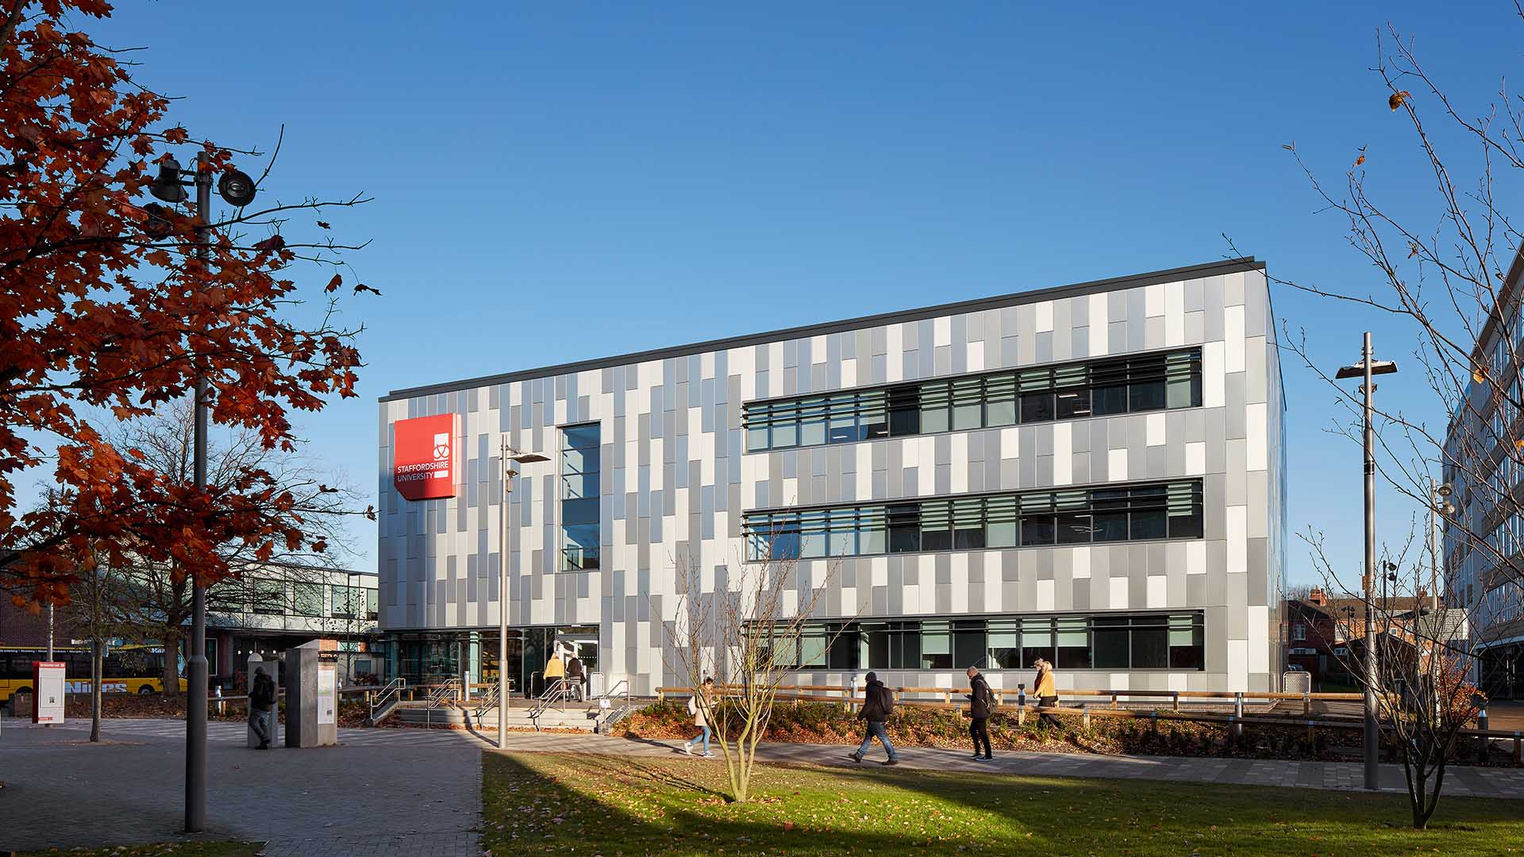
Wilding our campus competition
Wilding our campus competition
Bringing wildlife to university
Bringing wildlife to university

Slide 2
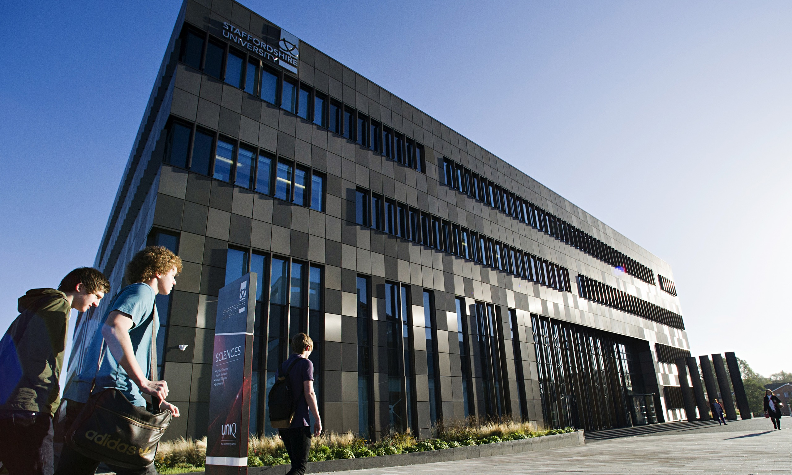
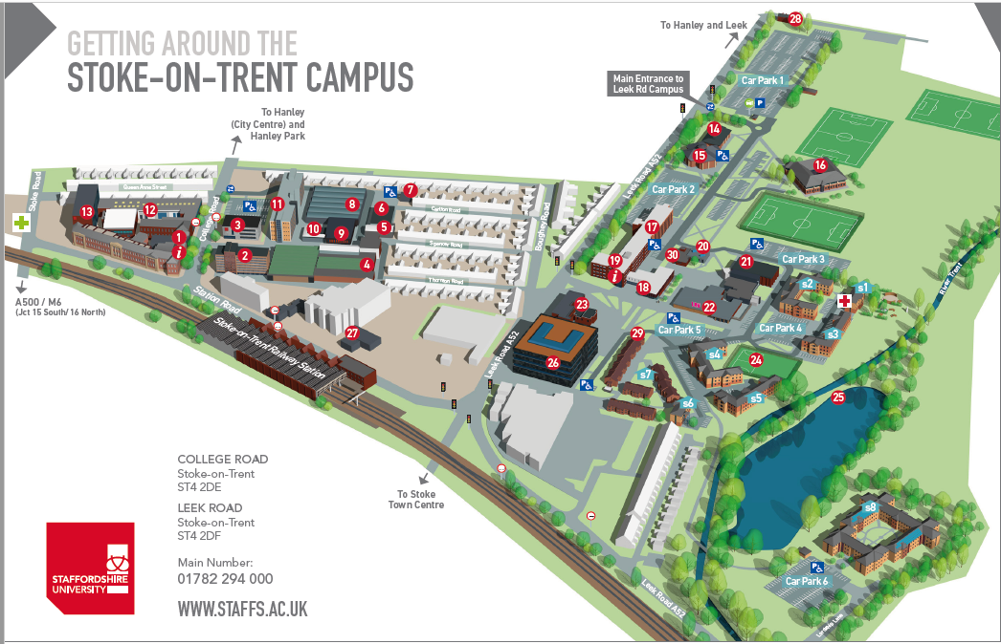
We want to improve the wildlife at our University
Can you help us?

Slide 3
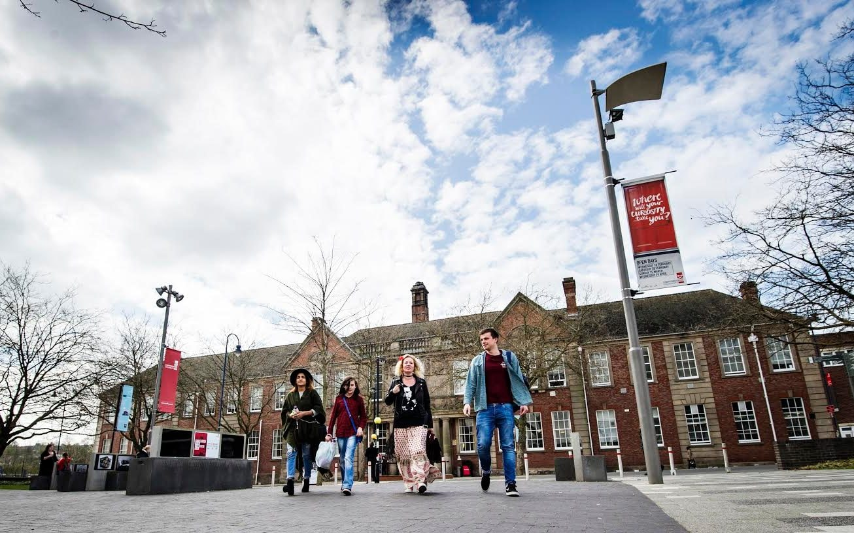
Wildlife needs habitats
The more habitats we have the more wildlife we will get

Slide 4
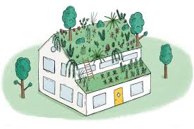
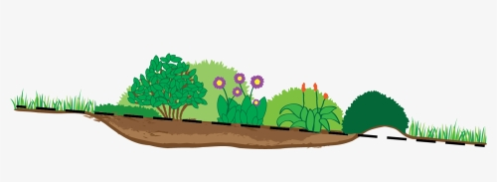
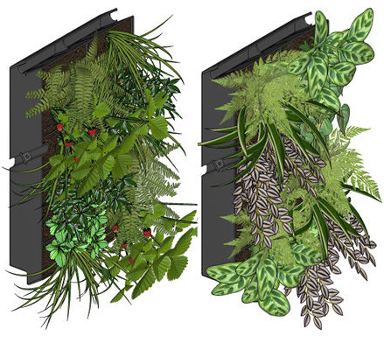
Different habitats

Slide 5
Wildlife needs habitats
The more habitats we have the more wildlife we will get
We have to put them somewhere sensible
They are better together - connectivity

Slide 6
How to enter
Download the map from the competition folder in the resources area
Send your entries including your name, age and address to Greenerstaffs@staffs.ac.uk or post them to:
Eleanor Atkins Science Centre Leek Rd Stoke-on-Trent ST4 2DE
Please include your name, age and address

