Slide 1
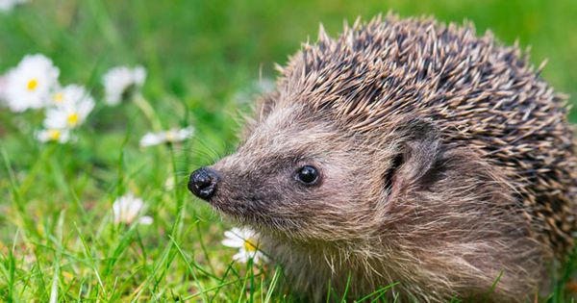
How to make a Hedgehog home
Baylee Jennings

Slide 2
Checklist
1
3
Bedding – (Small pet bedding/ Shredded Newspaper/ Leaves)
Insulation tape and/or Duct Tape
Plastic storage box OR wood box (Roughly 30L)
Drill
Knife/ Cutting tool
Marker pen
Pipe for tunnel OR tunnel could be made using wooden panels
Small plastic tubes OR cut up pieces of garden hose for ventilation/ drainage
2
30L
7
8
4
5
6
35cm
35cm
14cm

Slide 3
Step 1 – Making a tunnel (Adult assistance)
Cut the pipe to roughly 35cm in length, make sure the pipe is at least 13cm in diameter so the hedgehogs can easily pass through.
After cutting pipe to length tape over the ends using insulation tape or duct tape to get rid of any sharp edges.
OR
Cut 4 pieces of wood 30cm X 14cm
Fix pieces of wood to form square tunnel using either glue or a hammer and nails.
Again ensure edges are covered using tape to take away rough edges.

Slide 4
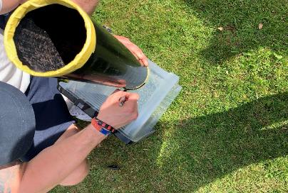
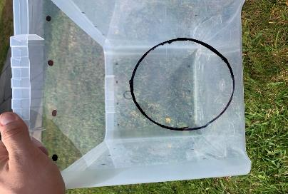
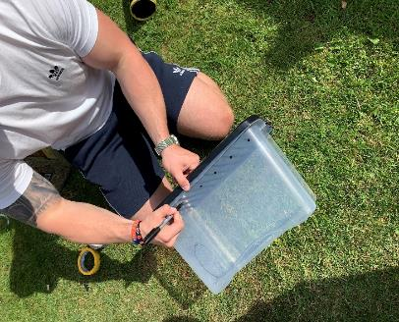
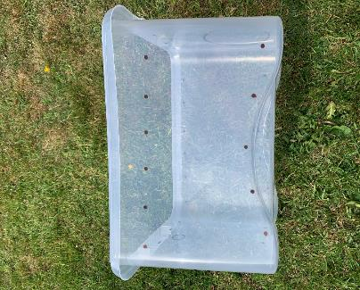
Step 2 – Marking cut-out areas
Draw around the ready made tunnel as a stencil to create guidelines for cutting, towards to bottom of one of the narrow sides of the storage/ wooden box.
Repeat this using the smaller pipe/ hose pipe as a stencil to create guidelines for cutting, on the opposite side of the box near to the top.
Now add some markers which will be used to create ventilation holes, along the top and bottom on all four sides of the box (I used 6 across the top and 5 along the bottom).

Slide 5
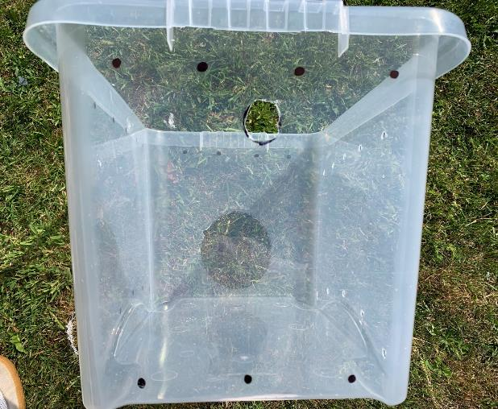
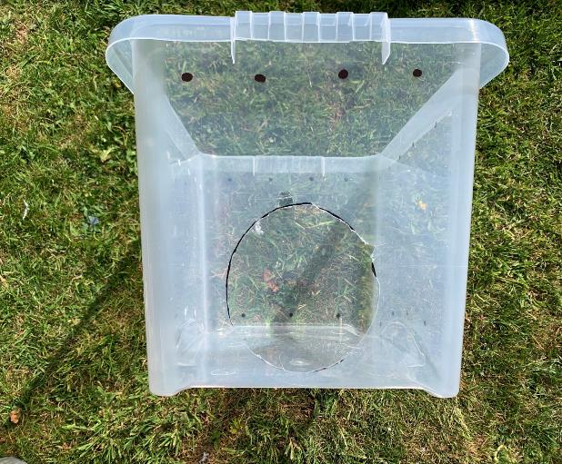
Step 3 – Cutting out (Adult assistance)
Using the drill, create the air holes where marked on all four sides using a 6mm drill bit. Be careful if using a plastic box not to push too hard as it may cause the box to split.
Cut out the hole for the drainage/ ventilation pipe by first drilling a hole in the centre of the circle and working your way around the edge using a knife or scissors. Take your time with this part not to slip.
Finally, cut an entrance hole for the tunnel to attach to in the same way the drainage hole was created. Again, take your time with this part not to slip when making the incisions.

Slide 6
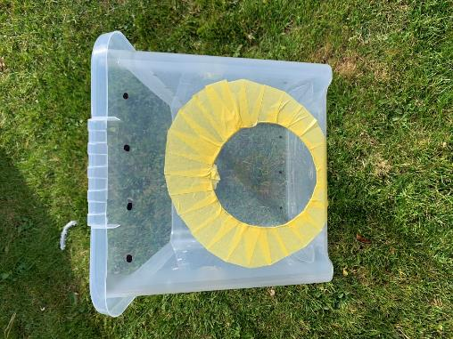
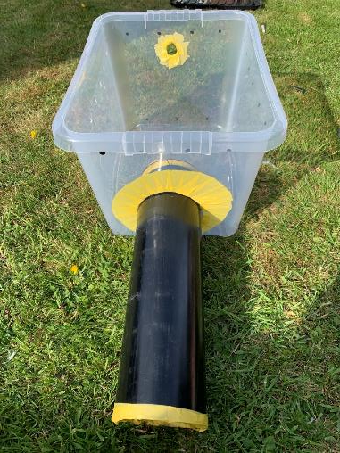
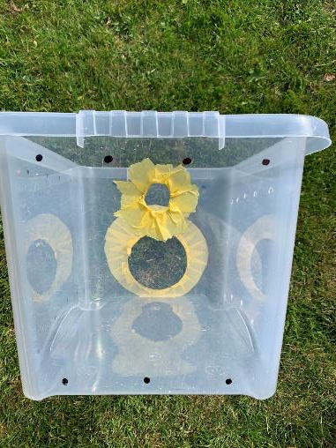
Step 4 – Tunnel and Drainage
Insert the tunnel into the holes cut in the previous step. Remember to tape over any rough and sharp edges on both the box and the tunnel.
Repeat this with the drainage tube on the opposite side of the box and tape (or glue) both the tunnel and drainage pipe in place using duct tape.

Slide 7
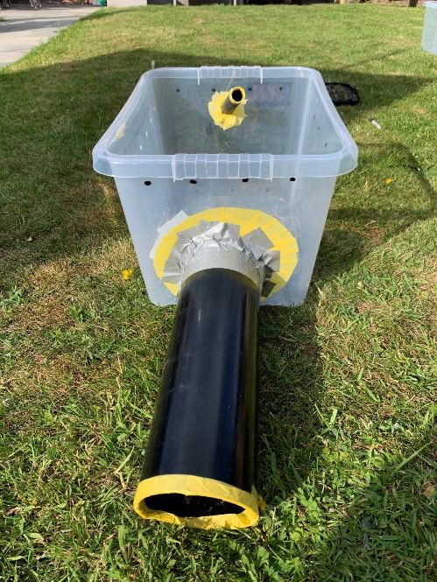
Step 5 – Add bedding
Cat or dog food works just as well for hedgehogs.
Tunnel attached to main box using duct tape
Add the bedding either animal bedding or shredded newspaper with some hedgehog food and water (optional) to attract hedgehogs to their new home.

Slide 8
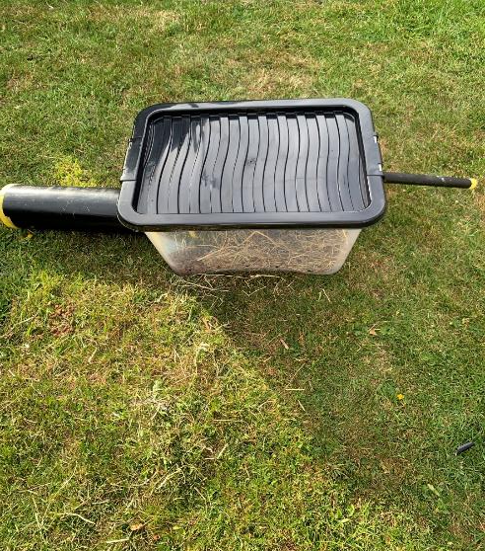
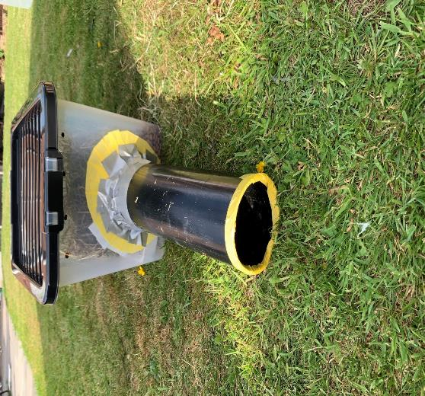
Step 6 – Final checks
Fix the lid to the top of the box and check that everything is tightly secured in place. Do not permanently attach the lid as you may wish to gain access to top up food or water. Your hedgehog home is now complete!

Slide 9
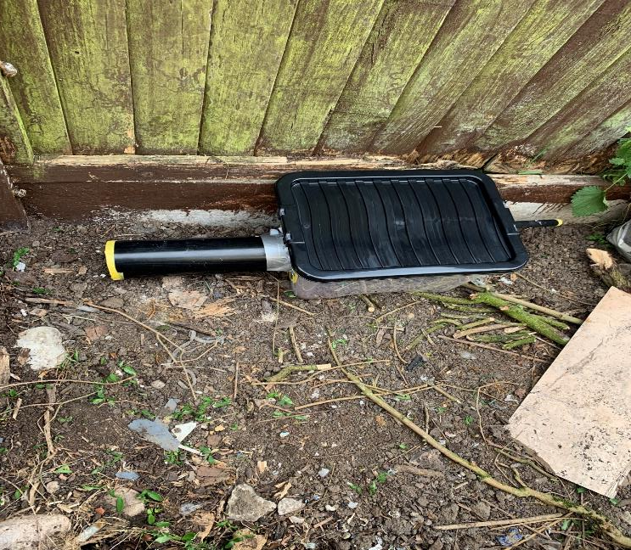
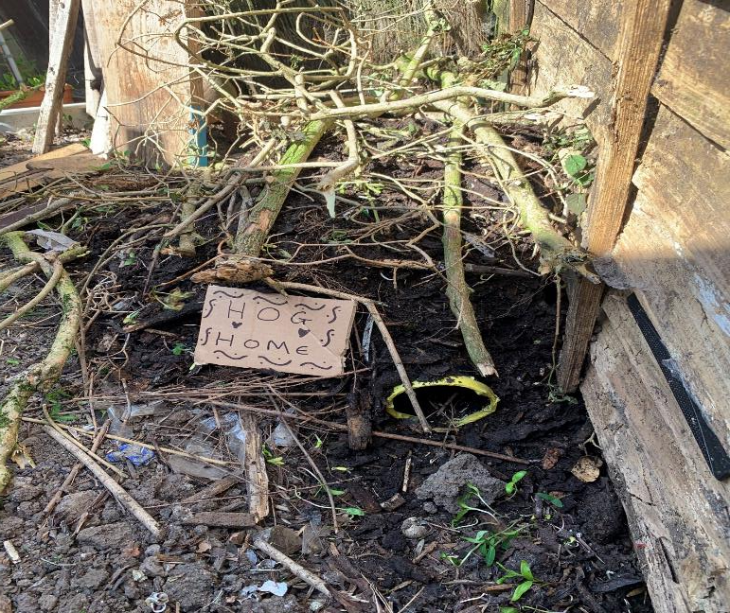
Finding a place for the home
Be careful not to cover the drainage/ ventilation tube!!
Find a quiet sheltered area of the garden and place your hedgehog house down providing easy access to the tunnel.
Now cover the hedgehog house with mud, leaves and bits of old dead wood to decorate and produce a more natural setting for the hedgehogs

Slide 10
COMPLETE!

