Slide 1
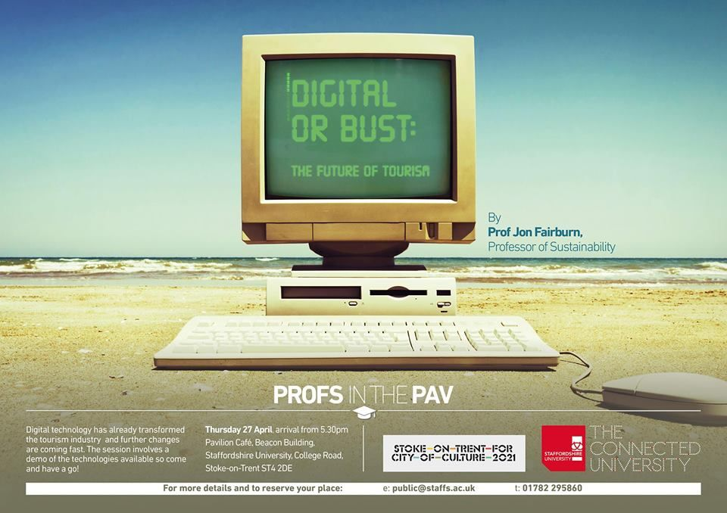

Slide 2
Twitter @tourismsu
#SMARTOUR
Notes:
Short 20 mins on tourism
20 mins on technology demos
20 mins on highlights of digital
Lot of people in the room to introduce who will be helping me

Slide 3
Digital impact on tourism
Technical opportunities and technical problems
The importance of trust and confidence
The importance of training

Slide 4
5 stages to the customer journey

Slide 5
1. Dreaming/inspiration

Slide 10
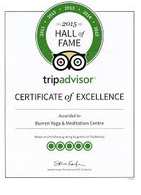
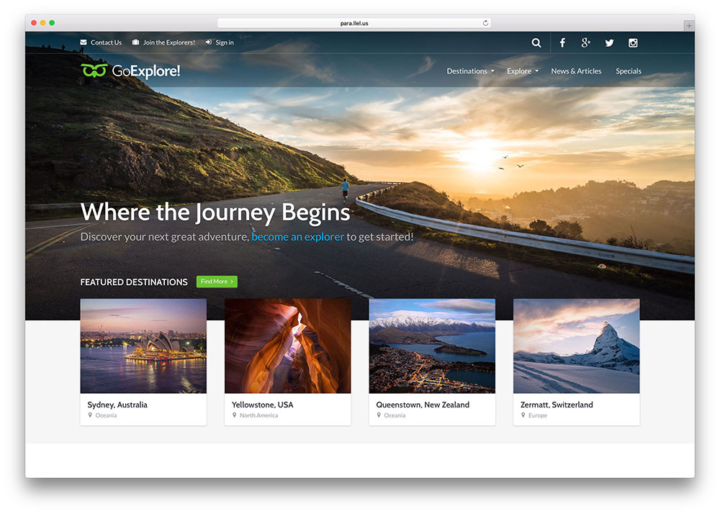
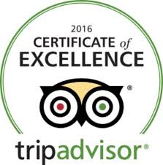
2. Planning

Slide 11
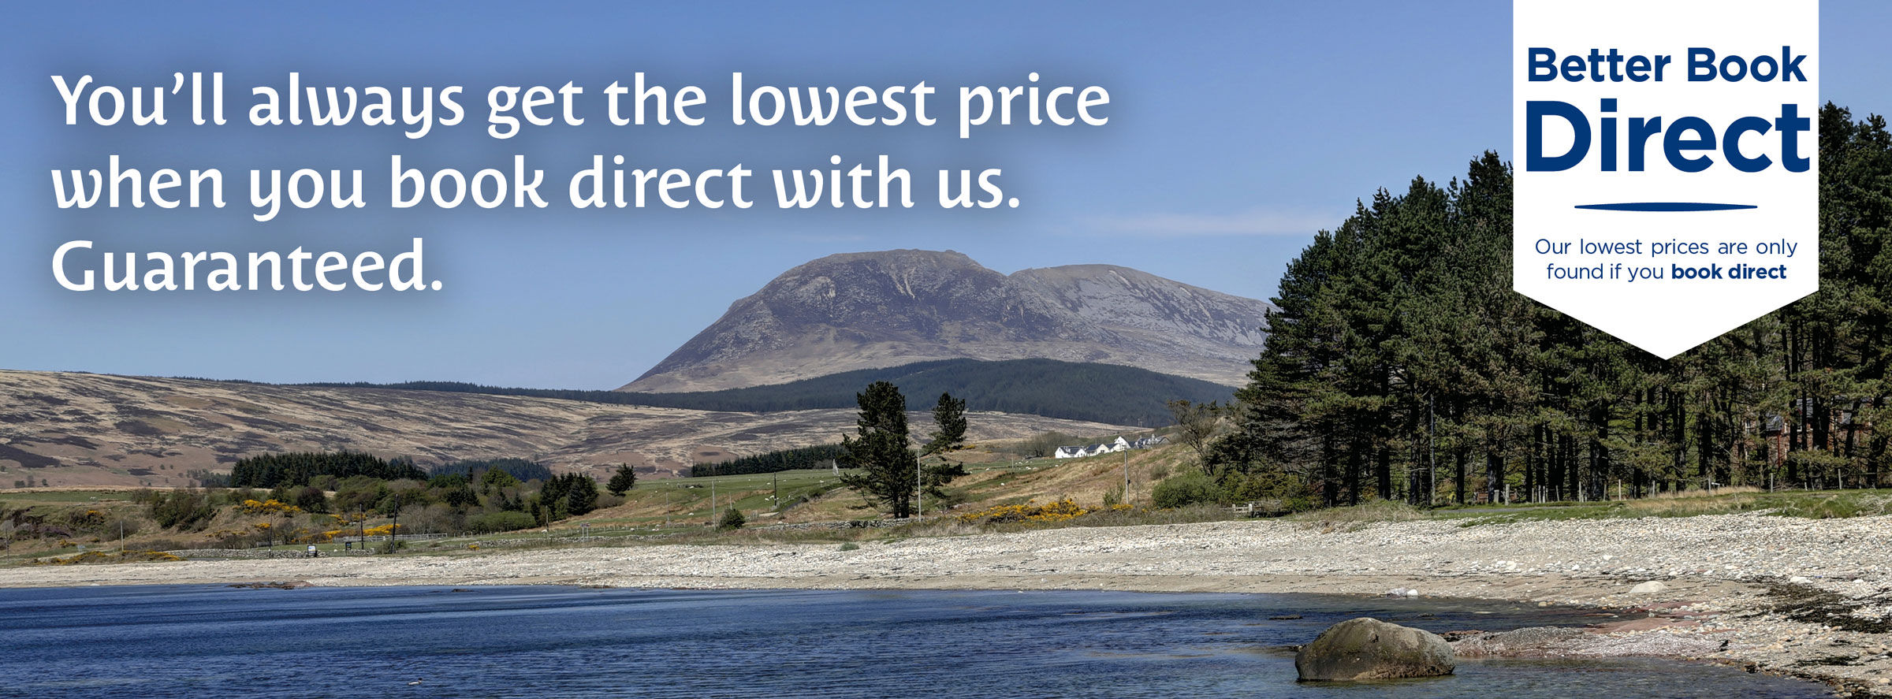
3. Booking
Notes:
In UK 25% of people go on holiday and book accommodation when they get there. No area has seen more change than booking and it is still evolving.

Slide 12
Tips
Book direct for the best deals
Booking direct keeps money in the hotel/accommodation provider that is more likely to be spent locally
Booking direct will give you a better range of rooms to choose from
Clear your cookies before going back to sites when booking
Notes:
EU report was damning last Autumn. OTA misleading the public by only showing rooms they had on their site. Many hotels afraid to criticise OTAs. OTAs now account for 40% of bookings in the accommodation industry.

Slide 13
Technology aspects
Desktop computer
Laptop computer
Tablets
SMART phones
Research showing that in some areas 80% of bookings are by mobile phone
Absolute numbers of bookings have fallen on other medias
Implication for design of websites and functionality

Slide 14
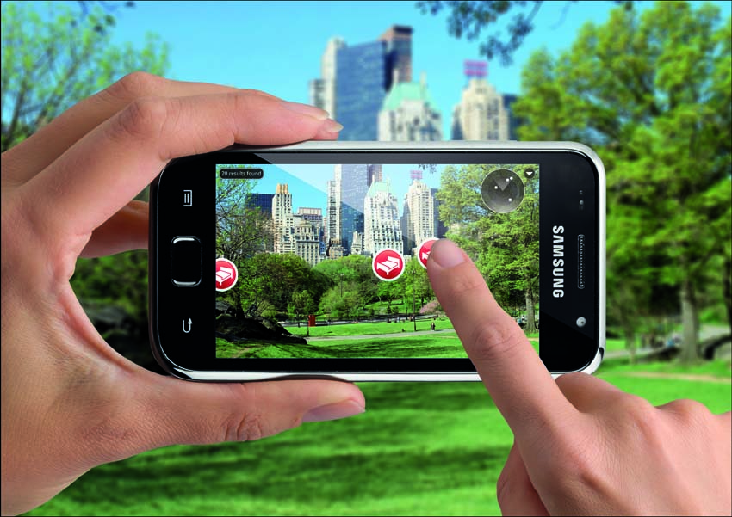
4. Experiencing
Authenticity ?
Personalisation?

Slide 16
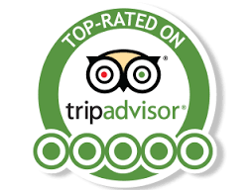
5. Sharing
About 25% of people share their experience on social media whilst on holiday
A further 49% share once they get home
41% of UK consumers write reviews about their travel experience

Slide 17
Virtual reality
Has been at pilot phase for a long time but may finally be ready for take off
VR offers ‘try before you buy’
Virgin offer such services in store – sales of trips show-cased with VR rose
Hotel chains are rolling it out in USA
Airlines have also used it to show the different classes on planes
Notes:
Note there are only 1/3 of retail outlets left in the USA compared to 20 years ago for selng holidays

Slide 18
Training – SMARTOUR project
Online tool - Personalised - Feedback provided
Designed by experts and industry across Europe
Aimed at L3,4,5 – workers and managers
Website smartourproject.eu
Tool - http://smartour.dcnet.eu/
Facebook - https://www.facebook.com/smartourproject/

Slide 19
Introductions
Paul Dobson – Digital marketing senior lecturer
Kris Winpenny – MSc Digital Marketing Management student and Staffs Uni employee
Carol Southall – Award Leader for Tourism courses
Tom Ward – technical assistant on EU SMARTOUR project

Slide 20
Individual buildings or destinations
House of Parliament - http://www.parliament.uk/visiting/virtualtour/
Royal Troon Clubhouse http://www.pikodesign.com/tour/rt/
Discover Bordeaux http://www.bordeaux-tourism.co.uk/Discover-Bordeaux/Virtual-tour-Bordeaux-360
Scarborough https://scarborough360.co.uk/scarborough
Functionality can vary depending on software and users

Slide 21
Introductions 2
Mark Locker – Staffs Uni alumni CEO of Attractions.io
Andrew Dobson and Salman Hamid – MSc Digital Marketing Management and now Track Digital Marketing trackdigitalmarketing.com

Slide 22
Apps in the industry
Hotels.com App has been downloaded 50 million times - provides phenomenal level of detail to target customers for future sales http://mobiletraveltracker.hotels.com/
Latest data from 2017 travel and tourism app use
Use map features – 49.1%
Search Restaurant – 62.1%
Use GPS For Directions – 48.1%
Search Hotel – 46%
Search engine activities and attractions – 33.3%
Check in prior to flight – 23.9 %
Buy Tickets – 8.1%
Look For Public Transportation – 12.6%
Look for shopping – 36.1%
Search for Hotel – 11.2%
Check Weather – 55.8%

Slide 23
Big issues for apps
Maintaining currency of information
Huge data volumes often present on apps
Poor wifi /networks in many areas
Wifi easily overloaded in busy areas
Seen as a simple and low cost solution but good apps need money and expertise

Slide 26
Theme Park Apps – Attractions.io

Slide 27
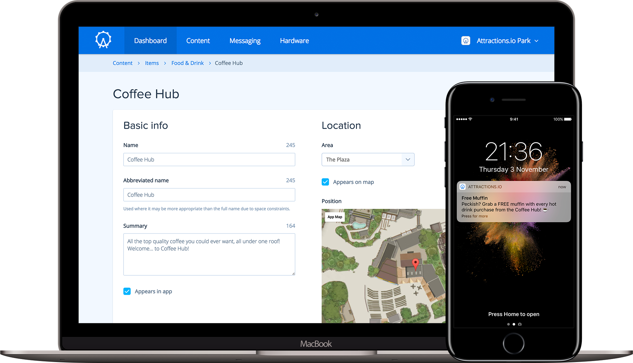

Slide 28
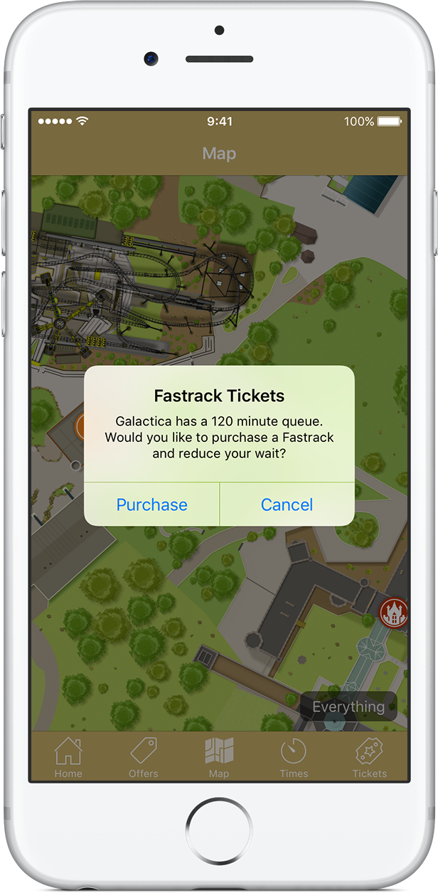
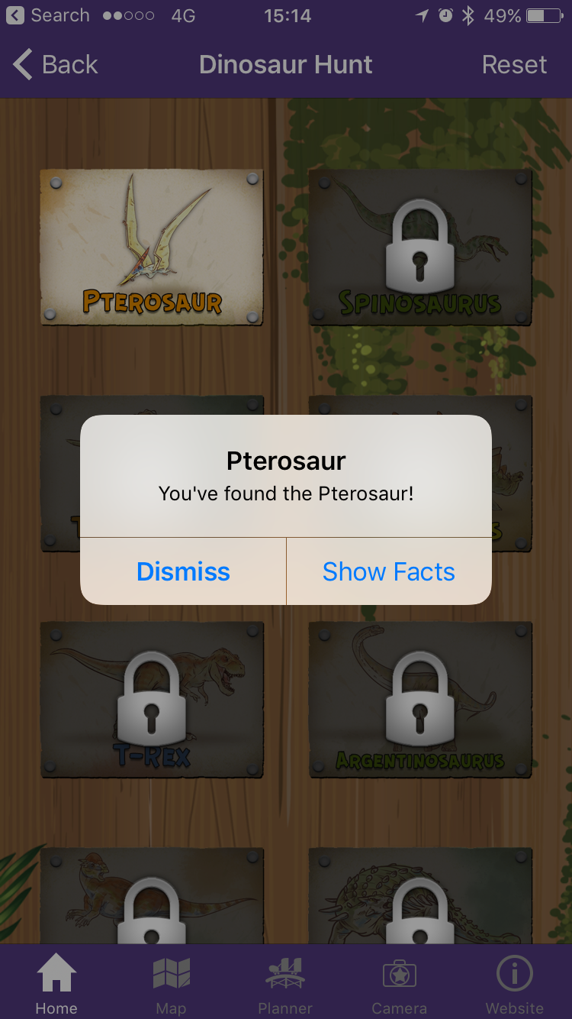

Slide 29
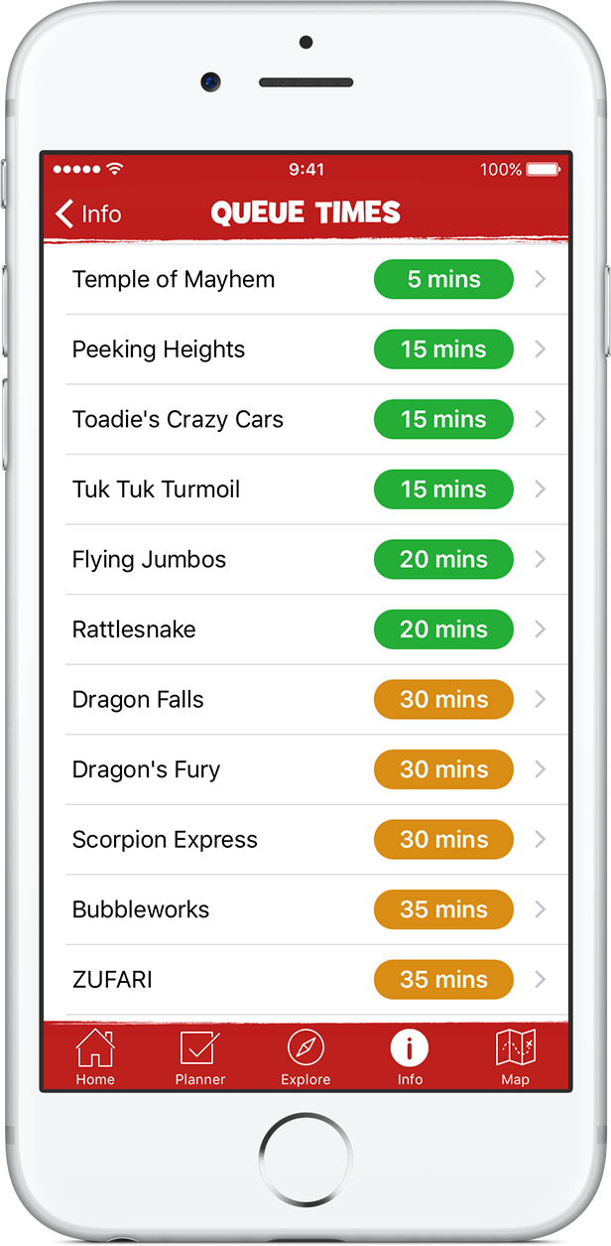
www.altontowers.com/app/

Slide 30
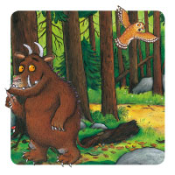
Top apps in the region – Be a Gruffalo Spotter
Forestry Commission
https://www.forestry.gov.uk/gruffalo

Slide 31
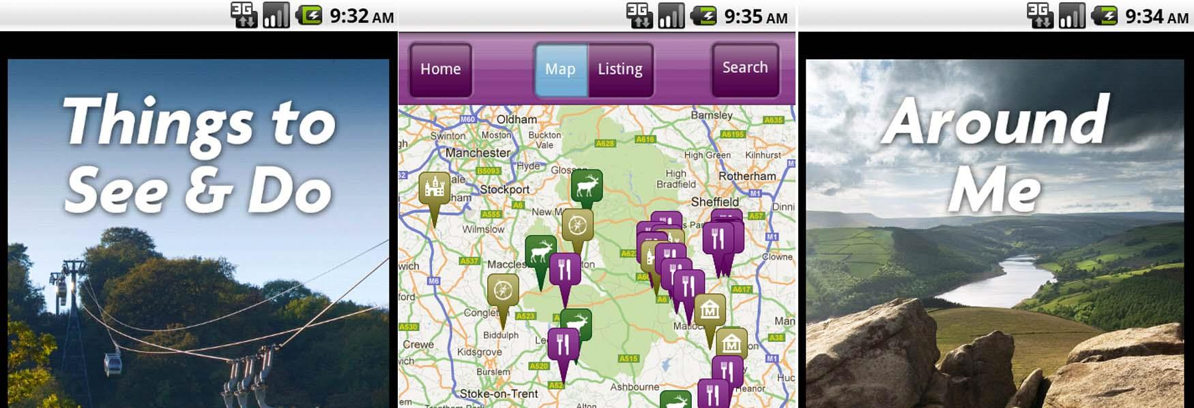
Visit Peak District app
https://www.visitpeakdistrict.com/visitor-information/apps-and-downloads

Slide 32
Newcastle under Lyme
https://www.visitnewcastleunderlyme.co.uk/news/newcastle-bid-launches-free-app-town-centre-visitors

Slide 33
Top train websites
http://www.seat61.com/ if you are in the dreaming stage – look at Great Train journeys
http://www.eurostar.com/ Stoke on Trent to Paris or Brussels (even a month before and tickets will often be about £55 – also last few seats can go for as little as £24)
https://www.bahn.de German Trains website but covers all of Europe and in English

Slide 34
Top 5 travel apps consistently amongst many bloggers
Skyscanner
Airbnb
Google translate
XE Currency
Trip advisor

Slide 35
What’s already here and will grow more?
Mobile check in for accommodation
Your mobile phone will act as a door key to your room. 24 hour access hotels already exist in Finland with no desk staff. Door codes are text messages.
Growth of AI in many areas – talking to your phone. AI bots to handle twitter accounts, more cashless transactions
A new app for Enjoy Staffordshire this summer?
A new app for the city this summer?

Slide 36
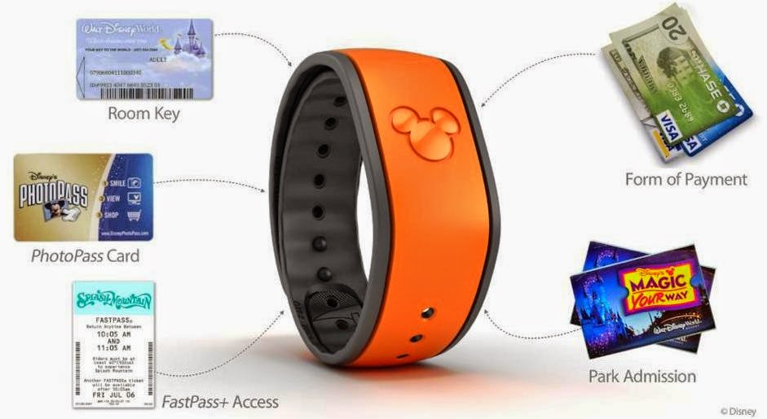
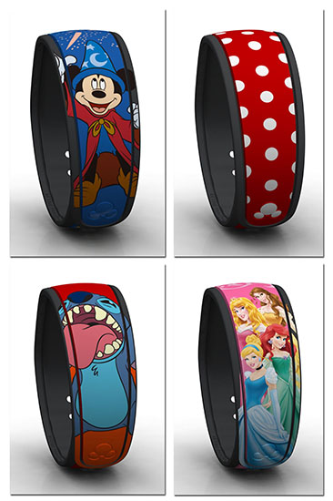
Disney’s Magic Band – a $1 billion spend
Personalised experiences built up including unlocking of special surprises
Customise your gifts with your own photos
Notes:
Personalised experiences built up including unlocking of special surprises
Photos and the ability to share photos
Customise your gifts with your own photos

Slide 37
Useful links
MSc Digital marketing Management http://www.staffs.ac.uk/course/SSTK-10823.jsp available FT and PT includes credited work epxerience
BSc Digital Marketing Management starts September includes credited work experience http://www.staffs.ac.uk/course/SSTK-10767.jsp
Carol Southall Award leader for Tourism http://www.staffs.ac.uk/staff/profiles/cs27.jsp
Paul Dobson digital marketing http://www.staffs.ac.uk/staff/profiles/pmd3.jsp
Kris Winpenny Kristofer.Winpenny@staffs.ac.uk
Mark Locker Attractions.io https://attractions.io/
Andrew Dobson and Salman Hamid – trackdigitalmarketing.com
Google daydream - https://vr.google.com/intl/en_uk/daydream/headset/

Slide 39
May 17th Tourism Mgt the Smart way @staffsuni free event (half day) for tourism and accommodation industry or those looking to work in it (lots of workshops)
https://smartour.eventbrite.co.uk

